Slide 1
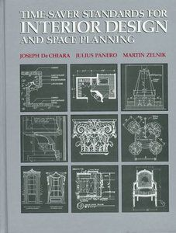
Time saver standards for interior design and space planning

Slide 2
https://drive.google.com/file/d/1OtQyDyQGmvUcezAjTU6IszDaCFKreWYi/view?usp=sharing

